Slide 1
Introduction to Sociology Chapter 9 Part 2 Social Stratification in the United States
Dr. Janet Long

Slide 2
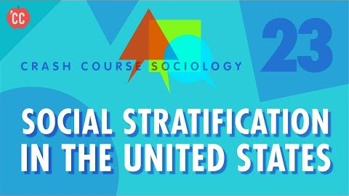
In the United States…

Slide 3
Inequality in the United States
U.S. society
Highly stratified
Rich have most of money, enjoy best schooling and health, and consume most goods and services

Slide 4
Income, Wealth, and Power
Income
Earnings from work or investments
Wealth
Total value of money and other assets, minus outstanding debts

Slide 5
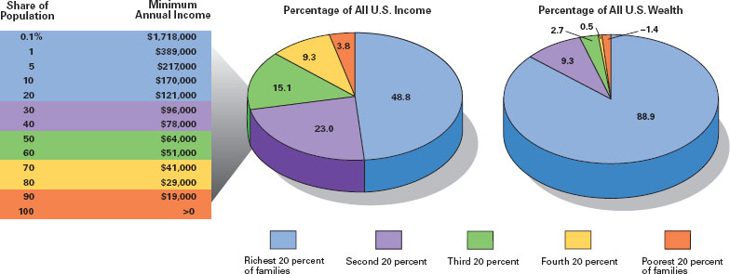
Distribution of Income and Wealth in the United States, 2011

Slide 6
Occupational Prestige
Work generates social prestige.
In any society, high-prestige occupations go to privileged categories of people.
Check Table 8-1 to see if your desired occupation is on the list.

Slide 9
Schooling
Schooling affects both occupation and income.
In 2011
88% of women and men aged twenty-five and older had completed high school
30% of women and 31% of men were college graduates

Slide 10
Ancestry, Race, and Gender
Family of origin influences future schooling, occupation, and income.
More than one-third of U.S. richest people derived fortunes from inheritance.
White people have higher overall occupational status than African Americans.
On average, women have less income, wealth, and occupational prestige than men.

Slide 11
Social Classes in the U.S.
Defining classes in U.S. society is difficult because of relatively low level of status consistency.
Standing may change among dimensions.
Social position may change during a lifetime.

Slide 12
Social Classes: Upper Class (1 of 2)
The upper-uppers
The “blue bloods”
Membership almost always based on ascription
Set apart by the amount of wealth their family's control
“Old money”
Devote time to community activities
Notes:
Rankings
Upper class
Middle class
Working class
Lower class
People often distinguish between the “new rich” and families with “old money.” Men and women who suddenly begin to earn high incomes tend to spend their money on status symbols because they enjoy the new thrill of high-roller living and they want others to know of their success.
Those who grow up surrounded by wealth, by contrast, are used to a privileged way of life and are more quiet about it.
Thus the conspicuous consumption of the lower-upper class can differ dramatically from the more private pursuits and understatement of the upper-upper class.

Slide 13
Social Classes: Lower-Upper
The lower-uppers
The working rich
The “new rich”
People often distinguish between the “new rich” and families with “old money.” Men and women who suddenly begin to earn high incomes tend to spend their money on status symbols because they enjoy the new thrill of high-roller living and they want others to know of their success
Notes:
The “new rich
Can still be excluded from some organization
More racial and ethnic diversity

Slide 14
Social Classes: Middle Class
Upper-middles
$116,000 to $205,000 yearly income
Education is important; high occupational prestige; involvement in local politics
Average-middles
$50,000 to $112,000 yearly income
Less occupational prestige; white collar or high-skilled blue collar jobs
Lower-middle class
Marxist “industrial proletariat”
Routine jobs with less satisfaction; vulnerable to financial problems caused by unemployment or illness
Notes:
Upper-middles
$116,000 to $205,000 yearly income
Education is important
High occupational prestige
Involvement in local politics
Average-middles
Less occupational prestige
White collar or high-skilled blue collar jobs
$50,000 to $112,000 yearly income
Income provides modest security
Lower-middle class
Marxist “industrial proletariat”
Routine jobs with less satisfaction
One-half own their own homes
One-fourth of children go to college
Vulnerable to financial problems caused by unemployment or illnes

Slide 15
Social Class: Lower Class
Lower class
46.3 million Americans classified as poor in 2011 (about 12.5% of the population)
70% complete high school; about 15% attend college
About 43% own their homes in less desirable urban neighborhoods/rural south
Others are “working poor” with minimum-wage jobs

Slide 16
The Difference Class Makes (1 of 4)
Social stratification is linked to health, values and attitudes, politics, and family life.
Compared to high-income people, low-income people are only half as likely to report good health.
Notes:
On average, live about five fewer years.
The toll of low income—played out in inadequate nutrition, little medical care, and high stress—is easy to see on the faces of the poor, who look old before their time.

Slide 17
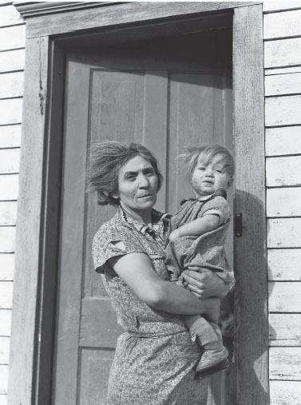
The Difference Class Makes (2 of 4)
Health
Amount and adequacy of needed medical care vary with income level
Cultural values and attitudes
Vary with social class position
Compared to high-income people, low-income people are only half as likely to report good health and, on average, they live about five fewer years.
Notes:
The toll of low income—played out in inadequate nutrition, little medical care, and high stress—is easy to see on the faces of the poor, who look old before their time.

Slide 18
The Difference Class Makes (3 of 4)
Politics
Follow complex pattern along class lines
Higher class: Conservative on economic issues; more liberal on social issues; more political involvement
Lower class: Liberal on economic issues; more conservative on social issues; lower voting records and political involvement

Slide 19
The Difference Class Makes (4 of 4)
Family and Gender
Family life shaped by social class.
Lower-class families are larger; child conformity to conventional norms expected.
Higher social standing families have different social capital and different parenting styles and expectations for children.
Gender-role responsibilities more rigid for lower-class families.

Slide 20
Social Mobility (1 of 2)
Upward
College degree or higher-paying job
Downward
Drop out of school, losing a job or divorce

Slide 21
Social Mobility (2 of 2)
Structural Social Mobility
Changes in society or national economic trends
Intragenerational mobility
Change in social position during a person’s lifetime
Intergenerational mobility
Upward or downward movement that takes place across generations within a family

Slide 22
Research Conclusions about U.S. Social Mobility
Social mobility has been fairly high.
Long-term trend has been upward.
Intergenerational mobility is small, not dramatic.
Social mobility since the 1970s has been uneven.
Short-term trend has been downward.

Slide 23
Mobility: Race, Ethnicity, and Gender
White people in United States have always been more privileged.
Women have limited opportunity for upward mobility.
Earnings gap between women and men still exists (77%).
Marriage pushes social standing upward.
Notes:
White people in U.S. have always been in a more privileged position than people of African or Hispanic descent.
From 1974-2011, worker income decreased by 9%, even as the number of work hours increased and cost of necessities went up.
Many industrial jobs have gone overseas, reducing the number of high-paying US jobs.
For the first time ever, more than half of Americans age 18 to 24 live with their parents.

Slide 24
Demographics of Poverty (1 of 3)
Age
In 2011, 48% of U.S. poor were young people age 24 or younger.
About 7.8 percent (3.6 million) of the poor are elderly.
Race and ethnicity
Two-thirds of all poor are white.
In 2011, 27.6% of all African Americans and 25.3% of Hispanics were poor.

Slide 25
Demographics of Poverty (2 of 3)
Gender
59% of poor are women.
Women who head households are at high risk of poverty.
Feminization of poverty is result of rapidly increasing number of households at all class levels headed by single women.

Slide 26
Demographics of Poverty (3 of 3)
Urban and rural poverty
Greatest concentration of poverty is found in central cities (20% poverty).
Most of the counties with the highest poverty rate in the United States are rural.
Almost 30 percent of the poor now live in mostly poor communities.

Slide 27
Explaining Poverty
Blame the poor
The poor are mostly responsible for their own poverty.
Culture of poverty produces a self-perpetuating cycle of poverty.
Time limits set for welfare.
Blame society
There is little opportunity for work.
William Julius Wilson
Society is mostly responsible for poverty.
Loss of jobs in the inner cities is the main cause of poverty.

Slide 28
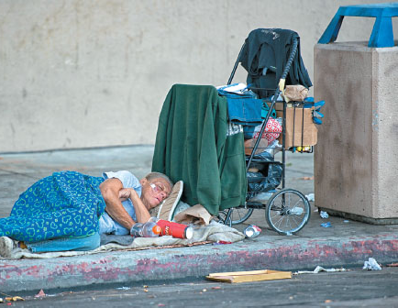
Homelessness
Causes
Poverty
Substance abuse and mental illness
Long-term
Structural changes in the U.S. economy
Cutbacks in social service budgets
Recent economic downturn
Is society responsible for poverty or are individuals themselves to blame? When it comes to homeless families, most people think society should do more.
Notes:
Is society responsible for poverty or are individuals themselves to blame? When it comes Bureau (2012); U.S. Department of Health and Human Services (2012). homeless families, most people think society should do more.
No precise count; Experts estimate 636,000 on any given night

Slide 29
Increasing Inequality, Increasing Controversy
Rising level of debate about income inequality in the United States.
Economic inequality has reached levels not seen since 1929.
Large majority of people agree with the statement, “This is a country in which the rich get richer and the poor get poorer.”

Slide 30
Can the Rest of Us Get Ahead?
Rising doubt that those willing to make the effort can enjoy economic security and expect to improve social standing over time.
Some claim the United States is no longer the land of opportunity.
The most striking social inequality is found by comparing living standards in various parts of the world.

Slide 31
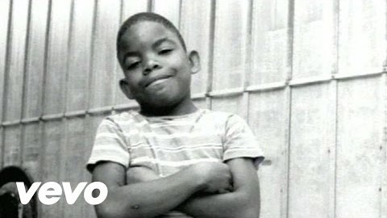
Inner City Blues
Marvin Gaye (1939-1984)
Album: What’s Going On (1971)

