Slide 1
Introduction to Sociology Chapter 9 Part 1 Social Stratification in the United States
Dr. Janet Long

Slide 2
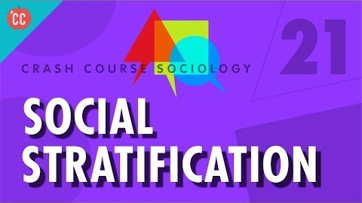
Crash Course Sociology

Slide 3
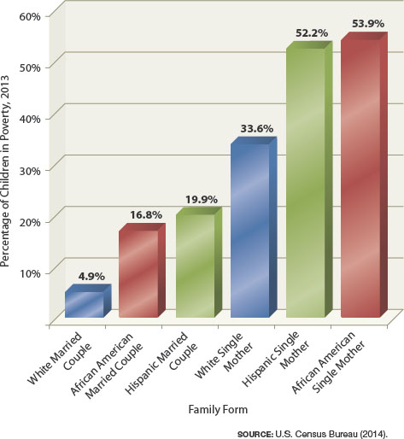
The Power of Society
What are a person’s odds of being born into poverty?

Slide 4
Social Stratification
System by which a society ranks categories of people in a hierarchy
In the U.S., stratification is based on: wealth, income, occupation, family background and power.
Our social standing is largely the result of the way society structures opportunity and reward. We are all products of social stratification.

Slide 5
Basic Principles of Social Stratification
Social stratification
Is a trait of society
Persists over generations
Is universal (everywhere) but variable (inconsistent)
Involves not just inequality, but beliefs

Slide 6
Key Factors Defining Stratification
Wealth – the net value of money and assets a person has.
Income – a person’s wages or investment dividends.
Occupation – the job one has that is often tied to their education.
Family Background – parents pass their social standing onto their children.

Slide 7
Caste and Class Systems
Caste system
Social stratification based on ascription, or birth
Class system
Social stratification based on both birth and individual achievement

Slide 8
The Caste System
Birth determines social position in four ways.
Occupation
Marriage within caste
Social life restricted to “own kind”
Belief systems often tied to religious dogma

Slide 9
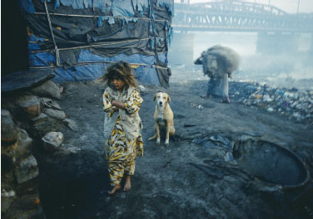
The Caste System in India
Caste has given way to a class system.
Achievement plays a greater part in social ranking.
Income and consumption are keys to social standing.
In rural India, the traditional caste system still shapes people's lives.
The “untouchables” are a category below the four basic castes.

Slide 10
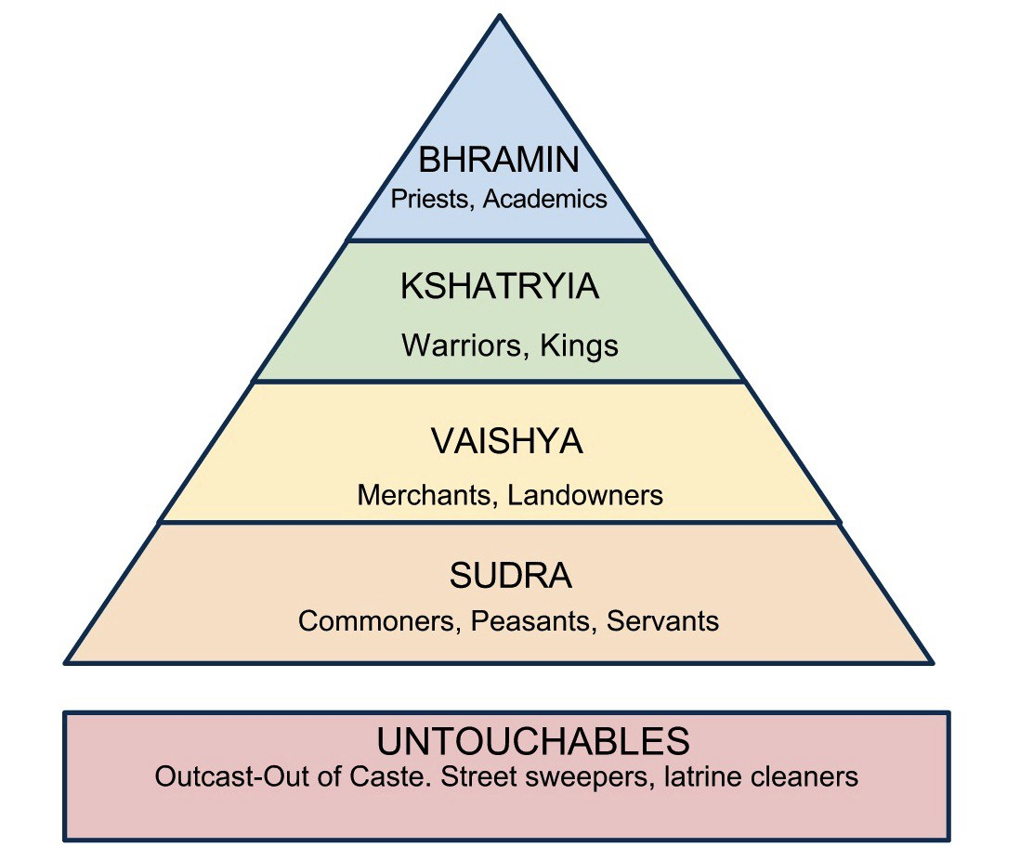

Slide 11
The Class System (1 of 3)
Meritocracy
Social stratification based on personal merit
Social mobility
Change in position within the social hierarchy
Status consistency
Degree of uniformity in a person's social standing across various dimensions of social inequality

Slide 12
Caste and Class: The United Kingdom (1 of 2)
Aristocratic England
Caste-like system of aristocracy
Estates
First estate: Church leaders
Second estate: Aristocracy
Third estate: Commoners

Slide 13
Harry and Megan
Primogeniture: a law stating that all property would be inherited by the firstborn son.

Slide 14
Explaining Stratification: Social-Conflict Theories
Karl Marx: Class conflict
Most people have one of two relationships to the means of production.
Capitalist society reproduces the class structure in each new generation.
Capitalism creates great inequality in power and wealth.
Oppression would drive working majority to organize and overthrow capitalism.
Notes:
Bourgeoisie own productive property
Proletariat works for the bourgeoisie

Slide 15
Why No Marxist Revolution?
Industrial workers have not overthrown capitalism.
Fragmentation of the capitalist class
Higher standard of living
More worker organizations
More extensive legal protections

Slide 16
Max Weber: Class, Status, and Power
Social stratification causes three levels of inequality.
Class position (economic inequality)
Status (social prestige)
Power
Socioeconomic status (SES)
Composite ranking based on various dimensions of social inequality.
Notes:
Socioeconomic status (SES)
Composite ranking based on various dimensions of social inequality

Slide 17
Explaining Stratification: Symbolic-Interaction Theory
Differences in social class position can affect interaction.
People interact primarily with others of similar social standing.
Conspicuous consumption involves buying and using products because of the "statement" they make.

