Slide 1
Introduction to Sociology Aging and the Elderly
Chapter 13
Dr. Janet Long

Slide 2
Gerontology
Gerontology – a field of science that seeks to understand the process of aging and the challenges encountered as seniors grow older.
Social gerontology – the specialized field of gerontology that examines the sociological aspects of aging.
Scholars of gerontology have learned that aging reflects not only the physiological process of growing order but also our attitudes and beliefs about the aging process.

Slide 3
Phases of Aging
Young-Old – Approximately sixty-five to seventy-four years old
Middle-old – Seventy-five to eighty-four years old
Old-Old – Over eighty-five.
Life Expectancy – the average number of years a person may expect to live.
From 1900 to 1994, the population increased from 3 million to 33 million. From then from 36 million in 2010. This increase is referred to as, “The graying of America.”
Women have longer life expectancies than men.

Slide 4
Women have longer life expectancies than men.

Slide 5
Baby Boomers
This section should be read with a critical eye. It is my opinion that the text is unfair to the baby boomer generation.
Born between 1946 and 1964
They came of age in the mid 1960’s and early 1970’s
Sixty-year-old baby boomers do not consider themselves old.
As of 2021, the youngest boomers will be 57; the oldest will be 75.

Slide 6
Baby Boomers, cont.

Slide 7
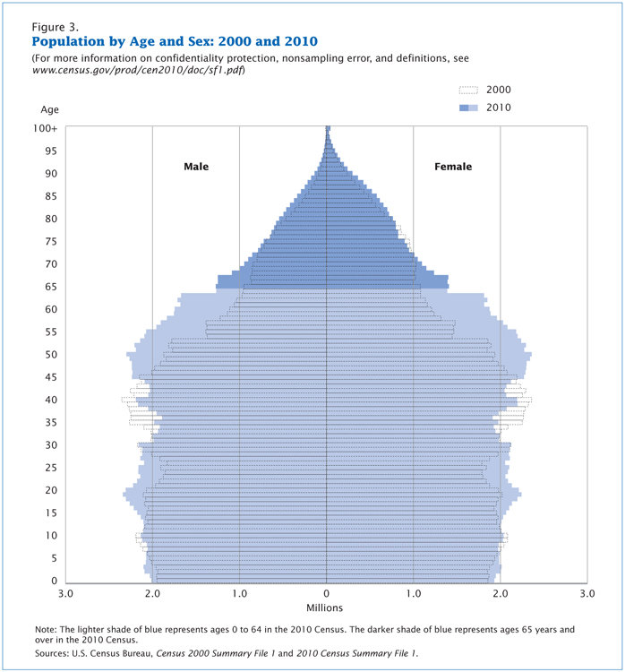
Baby Boom Bulge
The baby boom generation is the cohort driving much of the dramatic increase in the over-sixty-five population. Figure 13.6 shows a comparison of the U.S. population by age and gender between 2000 and 2010. The biggest bulge in the pyramid (representing the largest population group) moves up the pyramid over the course of the decade; in 2000, the largest population group was age thirty-five to fifty-five. In 2010, that group was age forty-five to sixty-five, meaning the oldest baby boomers were just reaching the age at which the U.S. Census considers them elderly. In 2020, we can predict, the baby boom bulge will continue to rise up the pyramid, making the largest U.S. population group between sixty-five and eighty-five years old.
Figure 13.6

Slide 8
Implications for the Aging Baby Boomers on Healthcare
Due to the higher numbers of baby boomers, healthcare will be impacted.
There will be a severe shortage of healthcare workers who specialize in gerontology.
Due to the aging population, aging boomers will bring economic growth to the healthcare industry.
Pharmaceutical industry, home healthcare services
Boomers at 65 are still physically active.
The high activity of 65-year-old boomers are driving innovation in the medical industry.

Slide 9
Aging Boomers and the Economic Impact
Baby boomers earned more than previous generations but spent their money lavishly.
Data shows they did not prepare adequately for retirement.
Two-thirds of boomers have not accumulated enough to maintain their lifestyles.
Therefore, boomers will work but spend less.
Social security is said to be at risk because boomers are higher in the population but fewer numbers in the younger generations.

Slide 10
Biological, Social and Psychological Changes
Primary Aging – Biological factors such molecular and cellular changes
Secondary Aging – controllable factors such as lack of physical exercise and poor diet.
Retirement – because people are living longer, they are expected to work longer.
You can begin collecting social security at 62 but only 75% of the monthly benefit…
If you were born between 1943 and 1954 your full retirement age is 66.
Accidents – such as falling
Excerpt from “Can’t We Talk About Something More Pleasant?”
Roz Chast (2014)

Slide 11
Prepare Yourself for Aging Parents

Slide 12
Excerpt from Can’t We Talk About Something More Pleasant
Chast, 126

Slide 13
Issues facing the Elderly
Grief – a psychological, emotional and social response to the feelings of loss that accompanies death or similar event.
Physician-assisted suicide – the voluntary or physician-assisted use of lethal medication provided by a medical doctor to end one’s life.
Poverty – seniors had good jobs, good retirements and good health care but lost much of that during the recession in 2008.
Ageism – discrimination based on age.
Gerontocracy – power held by older people
Elder Abuse – When a caretaker intentionally deprives an older person of care or harms a person in their care.

Slide 14
Signs of Elder Abuse
Type of Abuse | Signs and Symptoms
Physical abuse | Bruises, untreated wounds, sprains, broken glasses, lab findings of medication overdosage
Sexual abuse | Bruises around breasts or genitals, torn or bloody underclothing, unexplained STDs (sexually transmitted diseases)
Emotional/psychological abuse | Being upset or withdrawn, unusual dementia-like behavior (rocking, sucking)
Neglect | Poor hygiene, untreated bed sores, dehydration, soiled bedding
Financial | Sudden changes in banking practices, inclusion of additional names on bank cards, abrupt changes to will
Self-neglect | Untreated medical conditions, unclean living area, lack of medical items like dentures or glasses

Slide 15
If you suspect elder abuse…
Adult Protective Services – Department of Aging and Adult Services –
San Bernardino County
National Center for Elder Abuse
National Domestic Violence Hotline
Police Department

