Slide 1
Introduction to Sociology Chapter 11 Race and Ethnicity Part 2
Dr. Janet Long

Slide 2
Miscegenation
Miscegenation – the marriage or cohabitation by persons of different race.

Slide 3
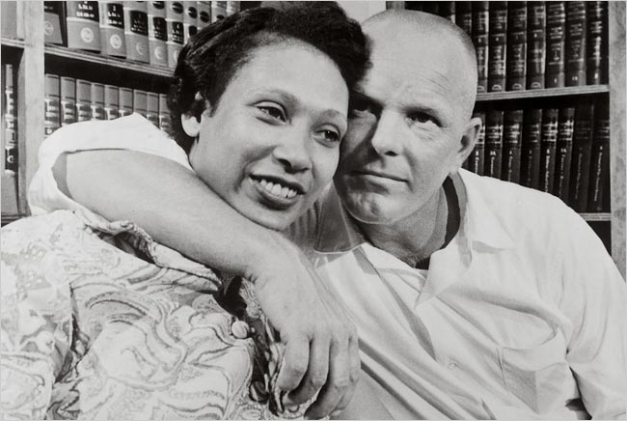
A Miscegenation Case: Loving v. Virginia
https://www.youtube.com/watch?v=vxpLSH8NPaw

Slide 4
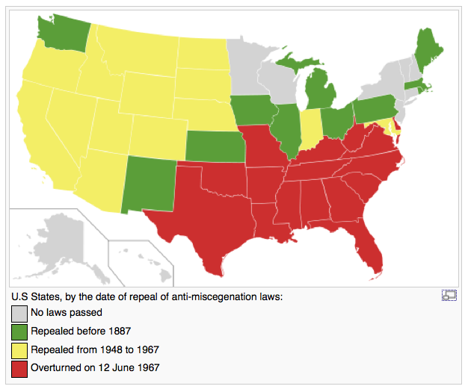
Repeal of Anti-Miscegenation Laws

Slide 5
Race and Ethnicity in the U.S. (1 of 4)
Native Americans
Experienced forced assimilation, relocation, and low social standing
Consists of forty-one American Indian nations and six Alaskan Native nations, which are made up of more than 600 smaller tribal groups
Some prosper; most Native Americans remain severely disadvantaged and share a profound sense of injustice

Slide 6
Race and Ethnicity in the U.S.
White Anglo-Saxon Protestants
33 million claim this background
Highly skilled and motivated immigrants
Higher social standing than other immigrants
Wealth and power peaked in 1950s
Assume terms race and ethnicity do not personally apply

Slide 7
Race and Ethnicity in the U.S.
African Americans
Being of African descent soon became synonymous with being a slave
Slavery became foundation of southern colonial plantation system
13th Amendment outlawed slavery
1950s–1960s national civil rights movement
Racial castes remain strong in the U.S.

Slide 8
African Americans
Sojourner Truth
Harriet Tubman
Ida B. Wells
Marian Anderson
The efforts of these four women greatly advanced the social standing of African Americans in the United States.
Notes:
Sojourner Truth, a slave, abolitionist and preacher, Harriet Tubman, an escaped slave led other slaves through the “underground railroad.” Ida B. Wells – born in slavery, became a teacher and activist against the synching of black men and Marian Anderson, an accomplished soprano who was denied opportunities to sing in prestigious venues.

Slide 9
Hispanic/Latino Americans in the U.S.
Hispanic/Latino Americans
Over 52 million people of Hispanic descent in U.S.
Cluster of distinct populations, each of which identifies with a particular ancestral nation
Median family income below national average
Mexican, Puerto Ricans, Cuban Americans

Slide 10
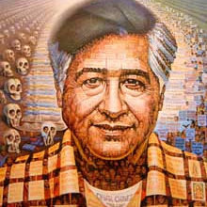
Cesar Chavez
https://www.youtube.com/watch?v=ECII78oL1Xo

Slide 11
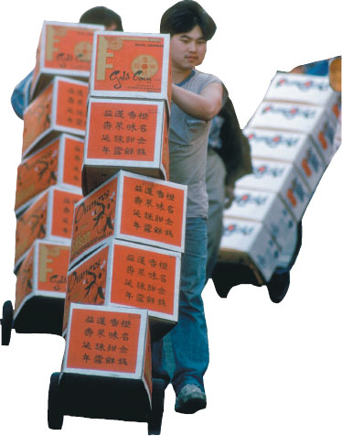
Asian Americans in the U.S.
Asian Americans
Enormous within category diversity
Attention commanded as high achievers
“Model minority” stereotype
Chinese Americans, Japanese Americans, and recent Asian immigrants

Slide 12
Arab Americans in the U.S.
Arab Americans
Increasing in size
Ancestors lived in a variety of countries and cultures differ from society to society
All social classes represented
Often stereotyped as terrorist and target of hate crimes
Notes:
Arab American communities can be found in many large cities on the East and West Coasts of the United States, but the heaviest concentrations are found across the upper Midwest.

Slide 13
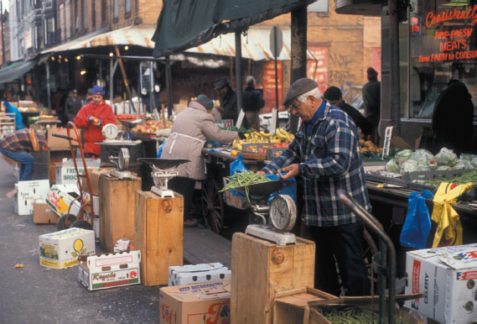
White Ethnic Americans in the U.S.
White Ethnic Americans
Persist in many U.S. cities, especially in the Northeast region of the country
Primarily working-class men and women whose ancestors came to U.S. as immigrants
Endured some prejudice and discrimination
To many more people, areas such as Philadelphia's Italian Market are a source of attractive cultural diversity.

Slide 14
THE END Part 2

Slide 15
Reflection 3
After the lectures and videos for Chapter 11, complete the Reflection assignment by writing two pages discussing what has had the most impact on you in this chapter. Include examples from any of the materials and anything you are seeing in the media that you can relate to the readings.
This assignment is worth 10 points and must be written in MLA Style. It will be due on Sunday, April 9th by 11:59 pm

