Slide 1
Introduction to Sociology Chapter 11 Race and Ethnicity Part 1
Dr. Janet Long

Slide 2
Covered in this Chapter
Racial, Ethnic, and Minority Groups
Stereotypes, Prejudice, and Discrimination
Theories of Race and Ethnicity
Intergroup Relationships
Race and Ethnicity in the United States

Slide 3
Trayvon Martin
In 2012, seventeen-year-old Trayvon Martin was shot and killed by twenty-eight-year-old George Zimmerman, who was the coordinator of his Florida community's neighborhood watch program.
Zimmerman was charged with second degree murder and later, found not guilty. Since Trayvon Martin’s death several African American men have been killed by law enforcement officers.
Do you think race was the factor?

Slide 4
How Race is Defined
The concept of race has evolved over time.
In the past, theorists defined race based on geographic regions, ethnicities, skin colors and more.
Race is socially constructed and is used as a means of sociologically understanding racial categories.

Slide 5
Race cont.
These professional organizations agree on how race should be defined:
American Sociological Association
American Association of Anthropologists
American Psychological Association

Slide 6
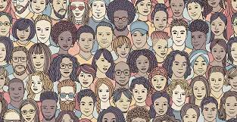
Ethnicity
Ethnicity describes shared culture
Practices, values, and beliefs of a group
They may include a shared language, religion, and traditions among other things.
Like race, the definition of ethnicity has changed over time.

Slide 7
Minority Groups
Minority - Groups of people singled out because of their physical or cultural characteristics.
These groups are singled out from others in society and are treated unfairly
The term “subordinate” group can be used interchangeably with minority group.
The term “dominate” group is opposite of subordinate group; people in the dominate group hold the most power in a given society. The subordinate group has little power compared to the dominate group.

Slide 8
Minority Groups cont.
Numerical Minority – not the same as minority group. Large groups can be considered minority due to their lack of power.
Ex: Apartheid in South Africa; the whites who are fewer in numbers exploited and oppressed Black people who were greater in numbers.
Distinguishing characteristics of minority groups:
Unequal treatment and less power
Distinguishing physical or cultural traits (skin color or language
Involuntary membership in a group
Awareness of subordination
LGBTQ community, people who practice religions not widely practiced, people with disabilities
(Wagley and Harris, 1958)

Slide 9
Scapegoat Theory
Scapegoat Theory – when the dominant group blames the subordinate group for its troubles.
Ex.1 – Hitler blamed the Jews for all Germany’s problems
Ex.2 – Immigrants are often blamed for job losses
Based on Dollards (1939) Frustration Theory

Slide 10
Stereotypes
The terms stereotypes, prejudice, discrimination and racism are often used interchangeably but they are very different.
Stereotypes are generalizations about groups of people
They can be based on almost any characteristic (race, gender, age, sexual orientation)
They can be positive or negative
They are do not take individual differences into account.

Slide 11
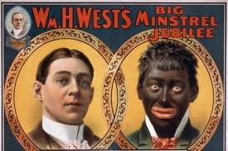
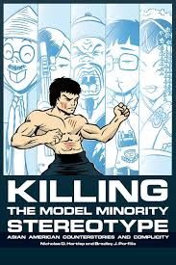
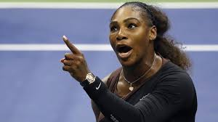
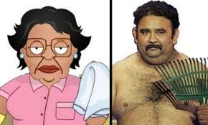
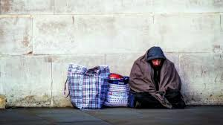
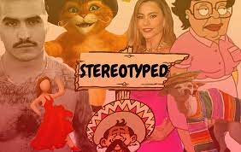
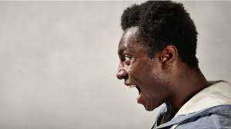
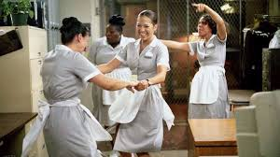
Typical Negative Stereotypes

Slide 12
Prejudice and Racism
Prejudice – refers to beliefs, thoughts, feelings, and attitudes held about a group
Prejudice is judging person before one has had any experience with them and is not specific to race.
Racism – used to justify the belief that one racial category is superior or inferior to others.
Institutional Racism – the way that racism is embedded into our society’s institutions (education, government, criminal justice, healthcare, others)

Slide 13
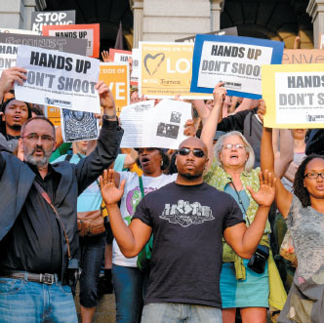
Discrimination
Discrimination – actions against a group of people based on age, religion, health, education, etc. Laws have been passed to address discrimination.

Slide 14
Discrimination cont.
Racial Steering – when groups are identified by race
When a newspaper identifies person (by race) of a crime.
When real estate agents direct prospective homeowners toward or away from certain neighborhoods based on their race.
Institutional Discrimination – the promotion of a group’s status simply by being part of the dominant group
White privilege – benefits the dominate group

Slide 15
Theories of Race and Ethnicity
Functionalism – the view that racial and ethnic inequalities must have served an important function in order to exist as long as it has.
Conflict Theories – often applied to inequalities of gender, social class, education, race, and ethnicity. This perspective examines the numerous past and current struggles between the white ruling class and racial and ethnic minorities.
Interactionism Theory - posits the view that race and ethnicity provide strong symbols as sources of identity. Some interactionist propose that symbols of race, not race itself, are what lead to racism

Slide 16
Intergroup Relationships
Genocide – the deliberate annihilation of a target (usually subordinate) group.
Expulsion – when a subordinate group is forced by a dominant group, to leave a certain area or country.
Segregation – the physical separation of two groups, particularly in residence but also in workplace and social functions.
De jure segregation – recognized legally but occurred without laws (Jim Crow south, apartheid in South Africa)
De facto segregation - racial, ethnic, or other segregation resulting from societal differences between groups such as socioeconomic or political disparity, without institutionalized legislation intended to segregate.

Slide 17
Intergroup Relationships cont.
Pluralism - People of all races and ethnicities are distinct but have equal social standing.
Assimilation – When minorities gradually adopt patterns of the dominant culture.
Amalgamation – when minority groups and majority groups combine to form a new group.

Slide 18
The End Part 1

